Slide 1

Algorithms and Problem Solving (15B11CI411)
EVEN 2022
Module 4: Lecture 4, 5
Design Technique: Backtracking
Jaypee Institute of Information Technology (JIIT)
A-10, Sector 62, Noida

Slide 2
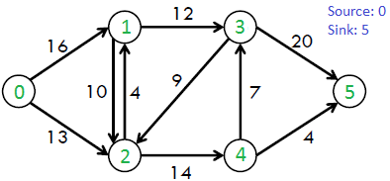
Network Flow Problem
Maximum flow problems involve finding a feasible flow through a single-source, single-sink flow network that is maximum.
In graph theory, a flow network is defined as a directed graph involving a source(S) and a sink(T) and several other nodes connected with edges.
Each edge has an individual capacity which is the maximum limit of flow that edge could allow.
Flow in the network should follow the following conditions:
For any non-source and non-sink node, the input flow is equal to output flow.
For any edge(E_{i}) in the network, 0<= flow(Ei) <= Capacity(Ei)
Total flow out of the source node is equal total to flow in to the sink node.
Net flow in the edges follows skew symmetry i.e. F(u,v) = - F(u,v) where F(u,v) is flow from node u to node v. This leads to a conclusion where you have to sum up all the flows between two nodes(either directions) to find net flow between the nodes initially.

Slide 3
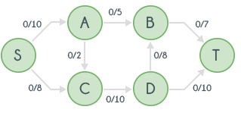
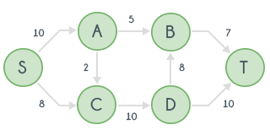
Ford Fulkerson Algorithm
Time Complexity: O(max_flow * E)
Space complexity: O(E + V)
FORD-FULKERSON(G,s,t)
for each edge (u,v)∈E[G]
do f[u,v] ← 0
f[v,u] ← 0
while there exists a path p from s to t in the residual network G_{f}
do c_{f}(p) ← min{c_{f}(u,v): (u,v) is in p}
for each edge (u,v) in p
do f[u,v] ← f[u,v]+c_{f}(p)
G
G_{R}
An augmenting path is a simple path from source to sink which do not include any cycles and that pass only through positive weighted edges.
A residual network graph (G_{R})indicates how much more flow is allowed in each edge in the network graph.
For every edge in the augmenting path, a value of minimum capacity in the path is subtracted from all the edges of that path.
An edge of equal amount is added to edges in reverse direction for every successive nodes in the augmenting path.
If there are no augmenting paths possible from S to T, then the flow is maximum.
The result i.e. the maximum flow will be the total flow out of source node which is also equal to total flow in to the sink node.

Slide 4
12
4/12
v₁
v₃
20
16
4/16
v₁
v₃
20
s
10
4
t
s
7
9
10
4
t
4/9
13
4
v₂
v₄
13
4/4
v₂
v₄
14
4/14
8
12
4/12
v₁
v₃
v₁
v₃
20
7/20
4
11/16
s
4
4
10
4
t
s
4
7/7
t
7
7/10
4/9
13
10
4
13
4/4
v₂
v₄
v₂
v₄
4
11/14

Slide 5
8
12/12
5
v₁
v₃
13
v₁
v₃
4
11/16
15/20
11
4
s
3
11
7
7
t
s
7/7
10
1/4
t
5
4/9
13
3
8/13
4/4
v₂
v₄
4
v₂
v₄
11
11/14
12
12/12
5
v₁
v₃
5
v₁
v₃
11/16
19/20
11
4
s
7
15
t
s
11
3
10
1/4
7/7
t
5
9
8
3
12/13
4/4
v₂
v₄
4
v₂
v₄
11
11/14
Total Flow = 23

Slide 6
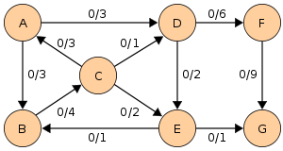
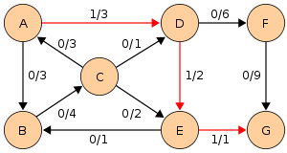
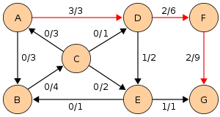
Edmonds-Karp algorithm
Implement the computation of the augmenting path p with a BFS
Breadth-first search gives the shortest path for graphs (Assuming the length of each edge is 1.)
Time complexity of Edmonds-Karp algorithm is O(VE²).
Source S ← A
Sink T ← G
Shortest path is ADEG using BFS
Flow = 1
Shortest path is ADFG using BFS
Flow = 1 + 2 = 3
Continue to obtain maximum flow.

Slide 7
Cuts of flow networks
A cut(S,T) of flow network G=(V,E) is a partition of V into S and T=V-S such that
The net flow across the cut(S,T) is defined to be f(S,T). The capacity of the cut(S,T) is c(S,T)
12/12
v1
v3
11/16
15/20
s
10
1/4
4/9
7/7
t
8/13
Max-flow min-cut theorem
v2
v4
4/4
11/14
S
T
A cut (S,T), where S={s,v1,v2} and T={v3,v4,t}.
The net flow across (S,T) is f(S,T)=12-4+11=19
and the capacity is c(S,T)=12+14=26.

Slide 8
Min-cut problem
12/12
In a flow network, the minimum cut separates the source and sink vertices and minimizes the total sum of the capacities of the edges that are directed from the source side of the cut to the sink side of the cut.
Once you find the max flow, the minimum cut can be found by creating the residual graph
Traverse this residual network from the source to all reachable nodes, these nodes define one part of the partition. Call this partition S.
The rest of the nodes (the unreachable ones) can be called T.
The size of the minimum cut is the sum of the weights of the edges in the original network which flow from a node in S to a node in T.
v1
v3
11/16
15/20
s
10
1/4
4/9
7/7
t
8/13
v2
v4
4/4
11/14
S
T

Slide 9
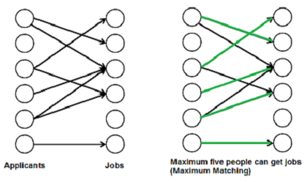
Bipartite Graph matching problem
A matching in a Bipartite Graph is a set of the edges chosen in such a way that no two edges share an endpoint.
A maximum matching is a matching of maximum size (maximum number of edges).
In a maximum matching, if any edge is added to it, it is no longer a matching.
Example:
There are M job applicants and N jobs.
Each applicant has a subset of jobs that he/she is interested in.
Each job opening can only accept one applicant and a job applicant can be appointed for only one job.
Find an assignment of jobs to applicants in such that as many applicants as possible get jobs.

Slide 10
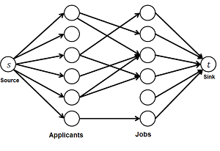
Represent the Job assignment problem as Max-flow problem
Create a flow network
Find Max-flow in the network
The maximum flow is actually the MBP we are looking for.

